Slide 1
Microsoft : Classifying Cybersecurity Incidents with Machine Learning
Submitted by
VenkataSubramanian S
MD112

Slide 2
Introduction:
This project is to classify the cybersecurity Incidents with the help of Machine Learning
Uses various classifier algorithms as below:
RandomForestClassifier
DecisionTreeClassifier
XGBClassifier

Slide 3
Objectives:
Enhancing the efficiency of Security Operation Centers (SOCs) by developing a machine learning model that can accurately predict the triage grade of cybersecurity incidents
To create a classification model that categorizes incidents as true positive (TP), benign positive (BP), or false positive (FP) based on historical evidence and customer responses
To train the model using the train.csv dataset and provide evaluation metrics—macro-F1 score, precision, and recall—based on the model's performance on the test.csv dataset

Slide 4
Libraries Used:
Numpy
Pandas
Sci-kit learn
Seaborn
Matplotlib
xgboost

Slide 5
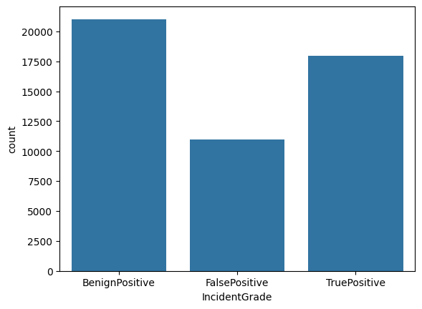
Data Exploration and Understanding:
Data types used in dataset:
float64(1), int64(30), object(15)
Data shape:
(50000, 36)
Distribution of Target:
IncidentGrade
Benign Positive = 21018
True Positive = 17985
False Positive = 10959

Slide 6
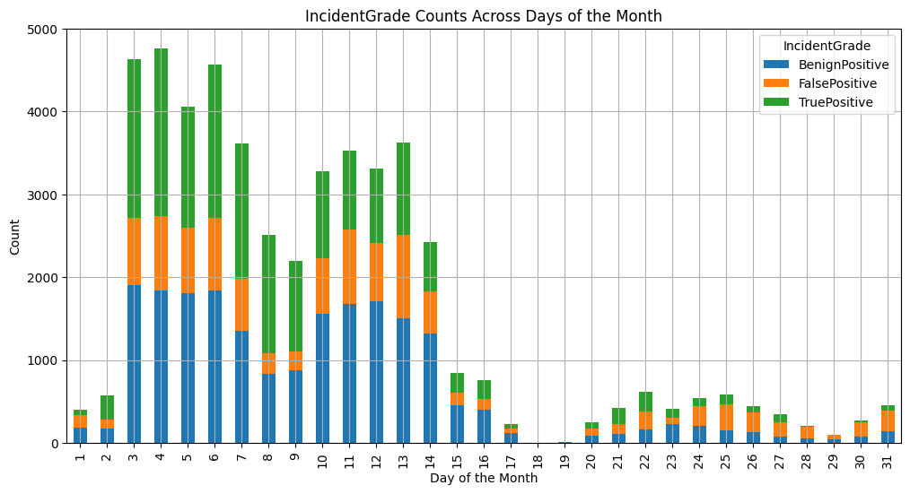
Exploratory Data Analysis (EDA):
Incident Grades v/s Days

Slide 7
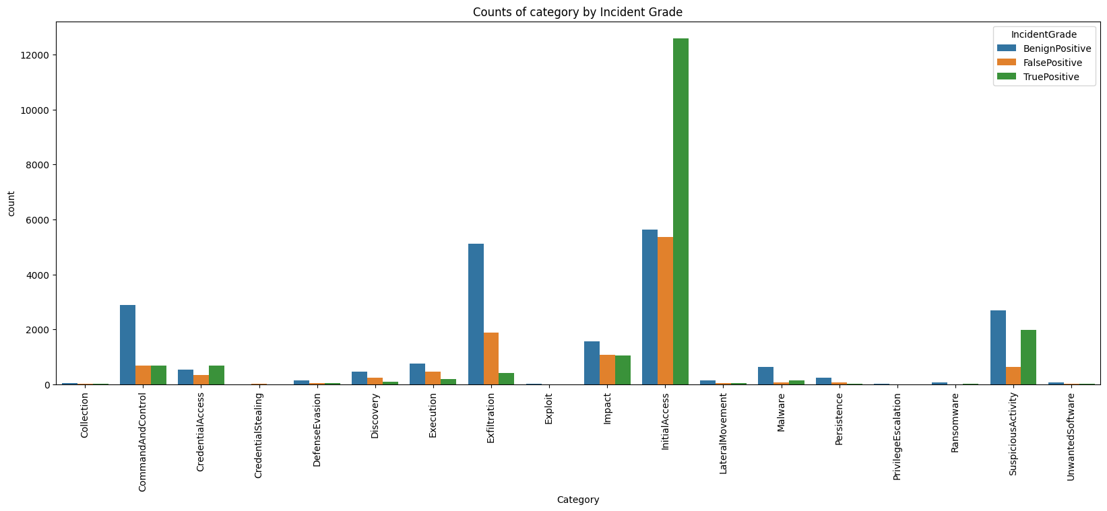
Exploratory Data Analysis (EDA):
Category Count by Incident Grade:

Slide 8
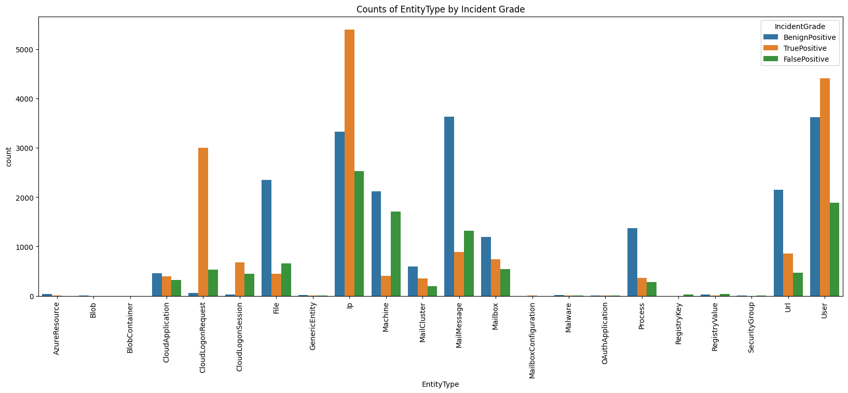
Exploratory Data Analysis (EDA):
Entity Type counts by Incident Grade:

Slide 9
Data Preprocessing:
Handling Missing Data:
Removed the columns which are having more than 50% missing values
Removed the duplicated columns and the NaN values count is 0
For the Target value, the missing values is replaced by the mode of the data
Feature Engineering:
The Timestamp is split into Year, Month, Day, Hours and time
The columns with same value is removed from the data frame
With correlation matrix, high correlated features are dropped
Categorical columns are encoded using Label Encoder
The Target values are resampled using the RandomOverSampler

Slide 10
Features Selection and Data Split:
Feature Selection:
The most important features are extracted using the Random Forest Classifier model
Important features:
['OrgId', 'IncidentId', 'AlertId', 'AlertTitle', 'Day', 'Time', 'Category', 'Hour', 'EntityType', 'IpAddress', 'City', 'Url', 'EvidenceRole', 'ApplicationId', 'Year']
Train Validation Split:
The data is split into X_train, X_test, y_train, y_test using the train_test_split
It is split as 80/20 split

Slide 11
DecisionTreeClassifier Model:
Parameters used:
max_depth=8,random_state=100,min_samples_split=10,min_samples_leaf=5,max_features="sqrt“
Metrics:
Metrics | Training(train) | Testing(train) | Training(test) | Testing(test)
Accuracy | 0.673822 | 0.672911 | 0.661122 | 0.660534
Precision | 0.728810 | 0.727882 | 0.699994 | 0.700987
Recall | 0.674016 | 0.672124 | 0.661220 | 0.660117
Macro F1 | 0.679167 | 0.678370 | 0.666219 | 0.665148

Slide 12
RandomForestClassifier:
Parameters Used:
criterion='entropy',max_depth=10,n_estimators=200,n_jobs=-1,random_state=100
Metrics:
Metrics | Training(train) | Testing(train) | Training(test) | Testing(test)
Accuracy | 0.783912 | 0.775289 | 0.796007 | 0.785029
Precision | 0.839771 | 0.831795 | 0.851990 | 0.843731
Recall | 0.784161 | 0.774276 | 0.796183 | 0.784286
Macro F1 | 0.788256 | 0.779681 | 0.800594 | 0.789289

Slide 13
XGB Classifier:
Parameters Used:
n_estimators=200,learning_rate=0.1,random_state=100,n_jobs=-1,max_depth=8
Metrics:
Metrics | Training(train) | Testing(train) | Training(test) | Testing(test)
Accuracy | 0.961558 | 0.921018 | 0.966517 | 0.925541
Precision | 0.961778 | 0.921903 | 0.966749 | 0.926537
Recall | 0.961572 | 0.920922 | 0.966511 | 0.925614
Macro F1 | 0.961564 | 0.921112 | 0.966539 | 0.925682

Slide 14
References:
https://scikit-learn.org/1.5/modules/generated/sklearn.tree.DecisionTreeClassifier.html
https://scikit-learn.org/1.5/modules/generated/sklearn.ensemble.RandomForestClassifier.html
https://xgboost.readthedocs.io/en/latest/python/python_api.html

